Slide 1
PPOL 628: Text as Data – Computational Linguistics for Social Scientists
Class 10: Topic Models

Slide 2
Today
Lecture: an overview of topic models.
Generative process and inference.
Moving discussion of evaluation methods to next week.
Lab: topic_models.R
Website: github.com/matthewjdenny/PPOL_628_Text_As_Data
Most slides from: https://www.cs.cmu.edu/~mgormley/courses/10701-f16/slides/lecture20-topic-models.pdf

Slide 3
Topic Models
Class of models for learning about the topical content of a corpus.
“Topic Model” can actually refer to any of of hundreds of different machine learning models.
We will focus on the most popular in this class of models – Latent Dirichlet Allocation.
Having a basic understanding of the math and its relation to model performance is useful.
Researcher degrees of freedom (preprocessing, hyper-parameters) can have a huge impact on performance.

Slide 4
Topic Models -- Motivation
You have a large number of documents (more than you can possibly read), and want to:
Sort these documents into thematic or topical categories.
Understand if different authors or groups of authors focus on different things.
Understand how themes, topics change over time, or with other covariates.
We could use dictionaries, vanilla clustering algorithms, supervised learning, but each has problems:
Dictionaries/Supervised Learning: hard to know ahead of time what all of the topics are, and all relevant words for all topics. Words can be relevant to more than one topic. Documents can be about more than one topic.
Vanilla Clustering: documents can be about more than one topic, may want to discover topics, learn what important words in those topics are.

Slide 5
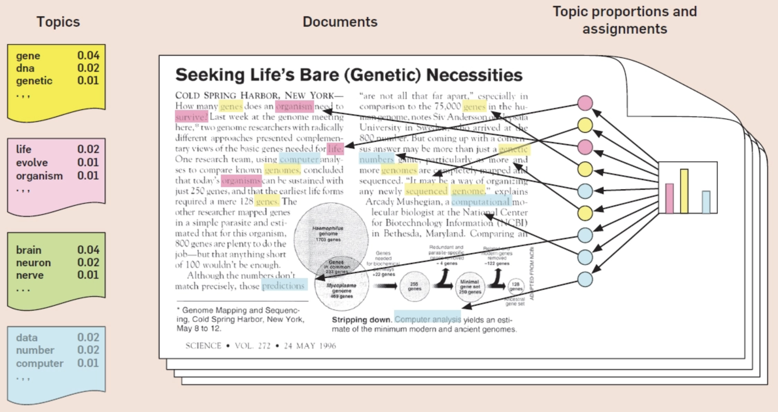
Topic Models -- Goals
Learn what topics each document is about:
Learn the proportion of each topic in each document.
Document-topic proportions as a document covariate.
Learn what words best represent each topic:
Learn the words with highest probability in each topic.
Display results visually to enable easy human interpretation.

Slide 6
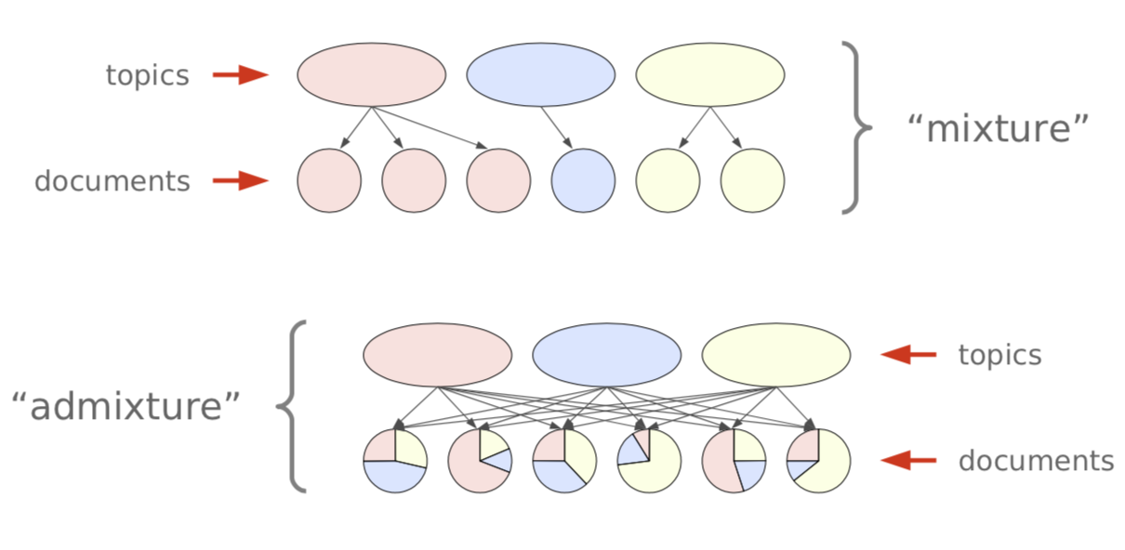
Mixture vs. Admixture Models
Mixture Model: Each document is about one topic, common words can be important in multiple topics.
Admixture Model: Each document is about multiple topics in different proportions. Words are more exclusive to topics.

Slide 7
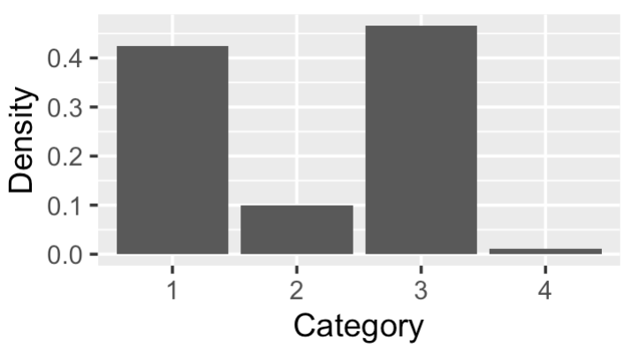
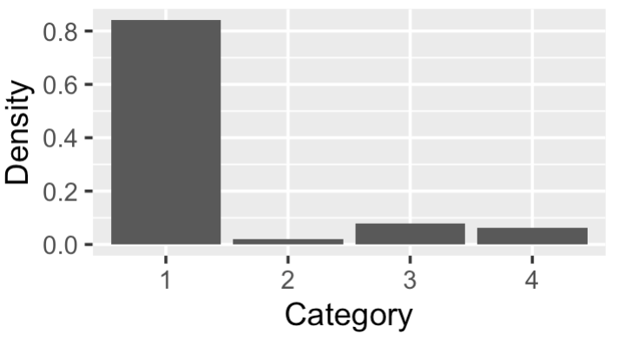
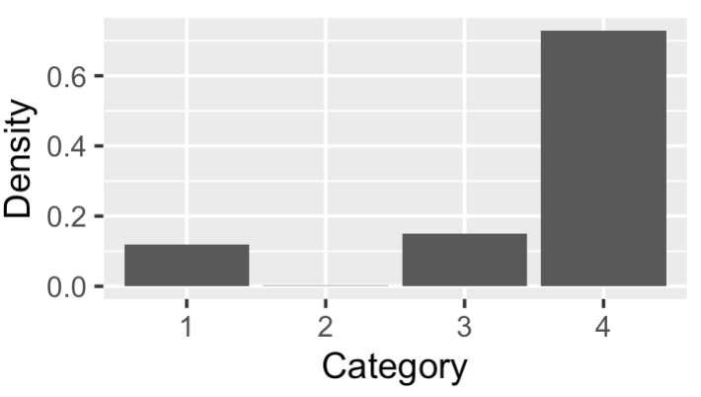
The Dirichlet and Multinomial Distributions
Multinomial Distribution: distribution over categories. Can take samples from distribution which are a category label.
M(.5,.25,.25) → {1,2,1,1,3,2,1,2,1,3,1,1,3}
Useful for modeling discrete categories like words within a given topic.
Dirichlet Distribution: distribution over multinomial probability vectors. Each sample is a multinomial distribution.
Useful for modeling distributions of categories like topics within documents, words within topics.

Slide 8
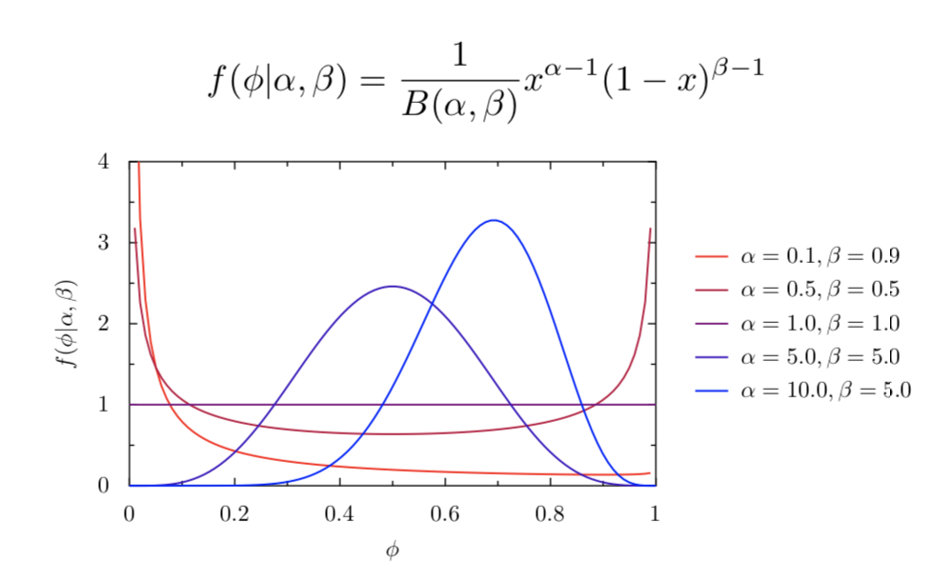
Dirichlet a as Generalization of Beta Dist.

Slide 9
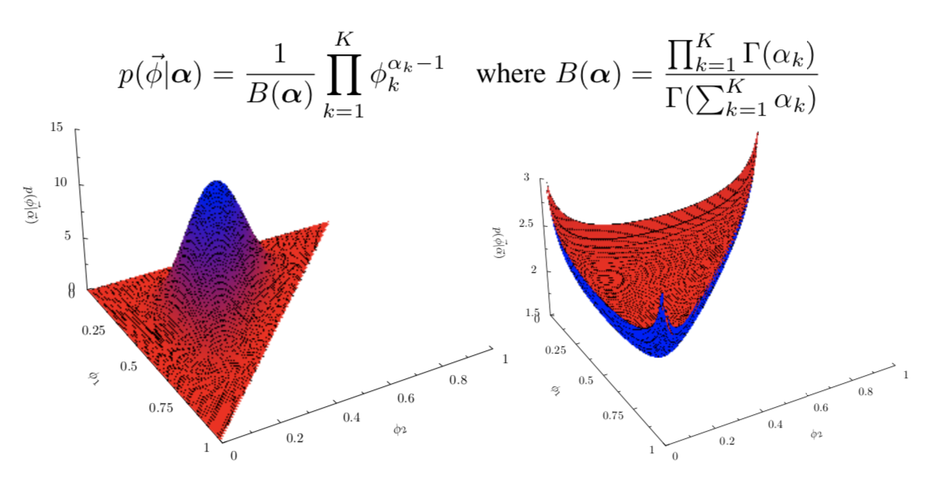
Dirichelt has two hyper-parameters 𝞪 and m
𝞪 the “smoothing parameter” controls how “smooth” distribution is.
m the “base measure” (a vector over categories) controls bias towards categories.

Slide 10
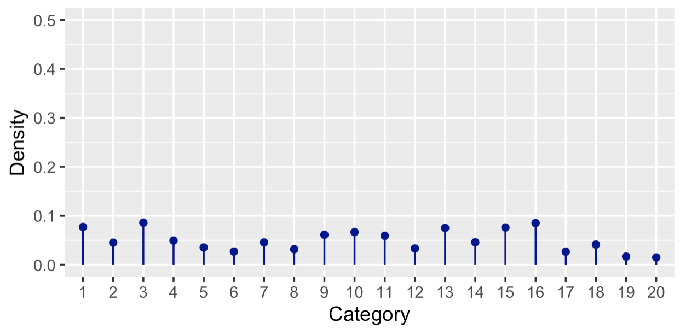
Dirichlet Distribution – Smoothing
Very large 𝞪 means draws from Dirichlet are likely to be very similar, with relatively equal probability across categories.

Slide 11
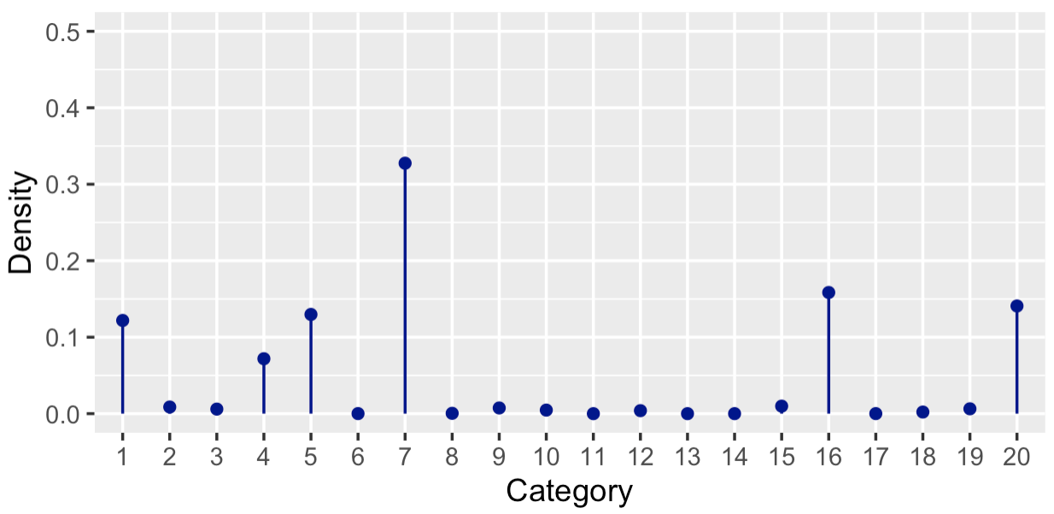
Dirichlet Distribution – Smoothing
Medium values 𝞪 means draws from Dirichlet are likely to exhibit more variation. Note that “size” of alpha is dependent on number of categories (grows with number of categories).

Slide 12
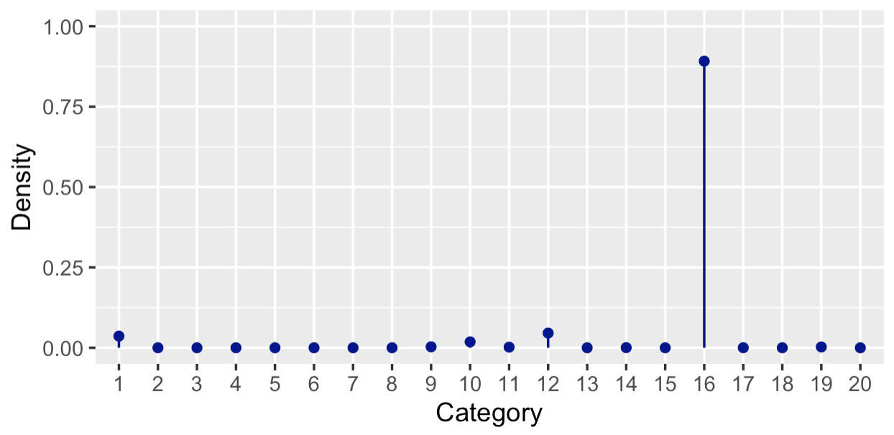
Dirichlet Distribution – Smoothing
Very small 𝞪 means draws from dirichlet are likely to be very peaked, with almost all probability mass on a single category.

Slide 13
Latent Dirichlet Allocation (LDA)
The canonical topic model (Blei, Ng, & Jordan, 2003).
A generative model: Posits a generative process for documents as first picking distribution over topics for that document, then picking words from topics.
Goal of inference is then to “invert” the generative process to recover the document-topic distributions and topic-word distributions.
Difficult inference problem with many solutions.
We will cover most common inference approach: collapsed Gibbs sampling.
Dozens of extensions to this model.
Correlated topics, dynamic (temporal), polylingual, semi-supervised, structural (incorporating covariates -- next week), hierarchical, etc.

Slide 14
Fixing Notation
Let 𝞪 be the smoothing parameter multiplied by the base measure, controlling the distribution over topics in documents.
Let 𝞫 be the smoothing parameter multiplied by the base measure, controlling the distribution over words in topics.
There are k ∈{1,….,K} topics, each of which is a distribution over words.
There are m ∈{1,….,M} documents, with n ∈{1,….,N_{m}} tokens in each document.
For token n in document m, its topic assignment is denoted by z_{m,n}
For token n in document m, its word type assignment is denoted by x_{m,n}
There are t ∈{1,….,V} word types (entries in our vocabulary).

Slide 15
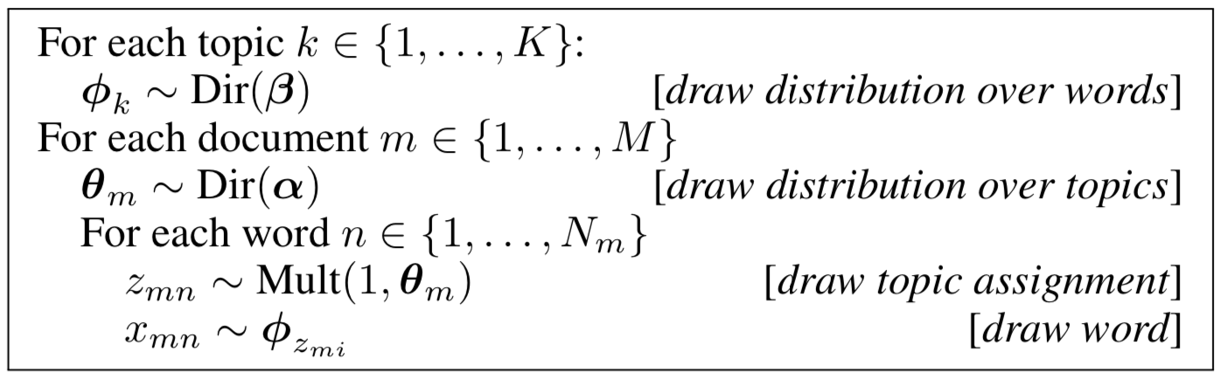
LDA Generative Process – Algorithm
We draw topic-word distributions, then document-specific topic distributions, and use both of these to generate the actual words in the documents.

Slide 16
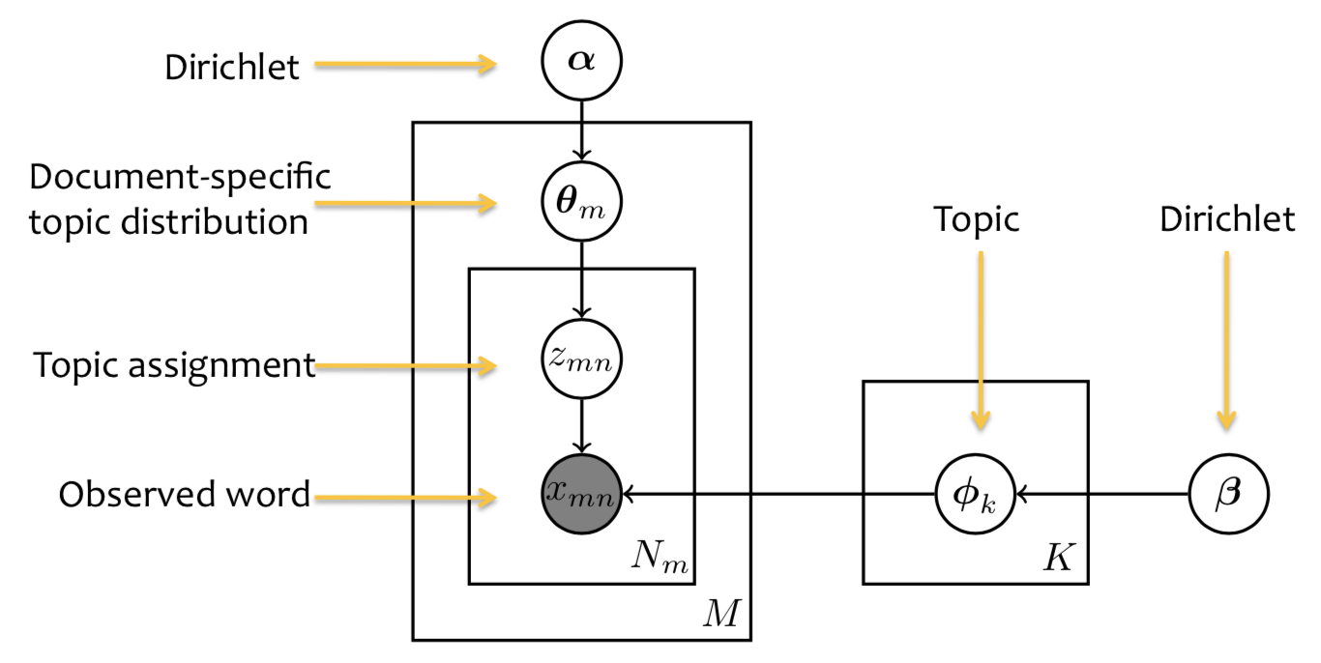
LDA Plate Model

Slide 17
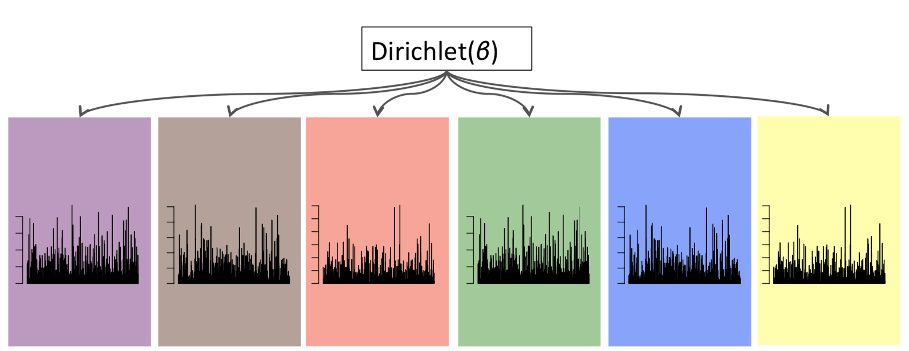
LDA Generative Process
Each topic is a distribution over words.

Slide 18

LDA Generative Process
We represent these topic-word distributions by thetas.

Slide 19
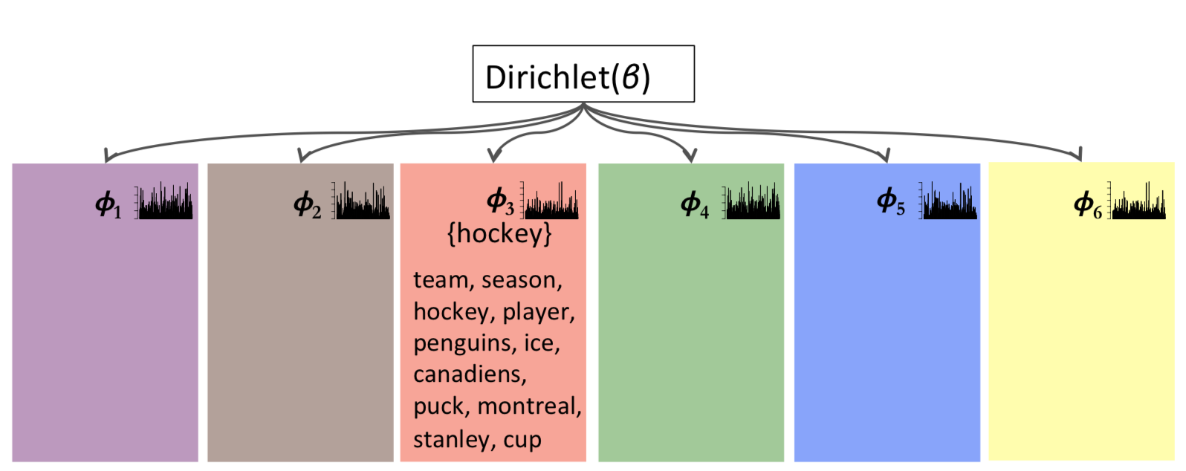
LDA Generative Process
Each topic is usually represented by the highest probability words in that topic, and researchers typically assign an overarching label to the topic.

Slide 20
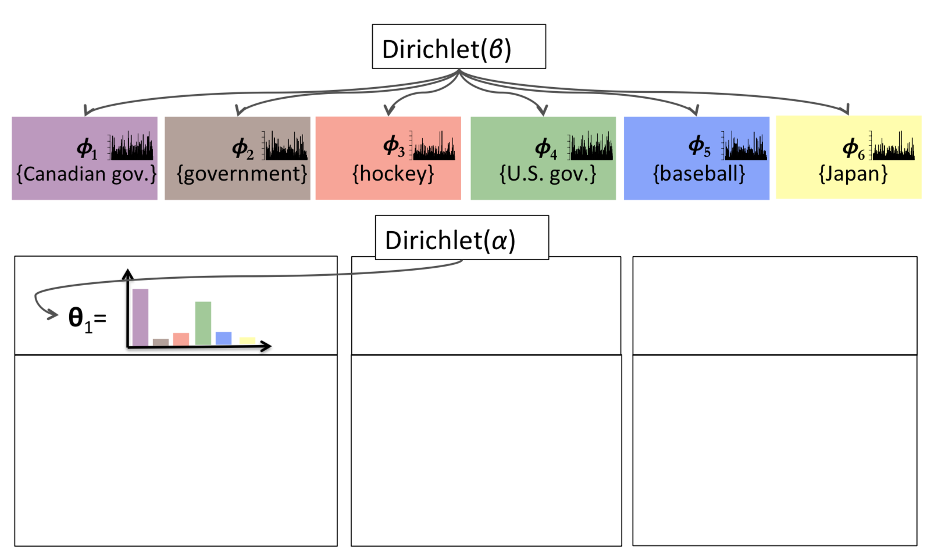
LDA Generative Process

Slide 21
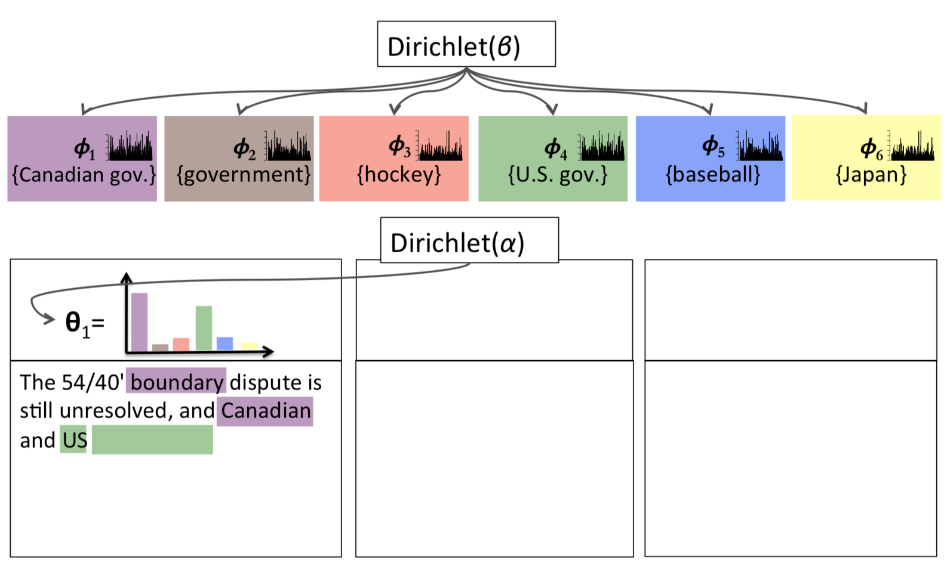
LDA Generative Process

Slide 22
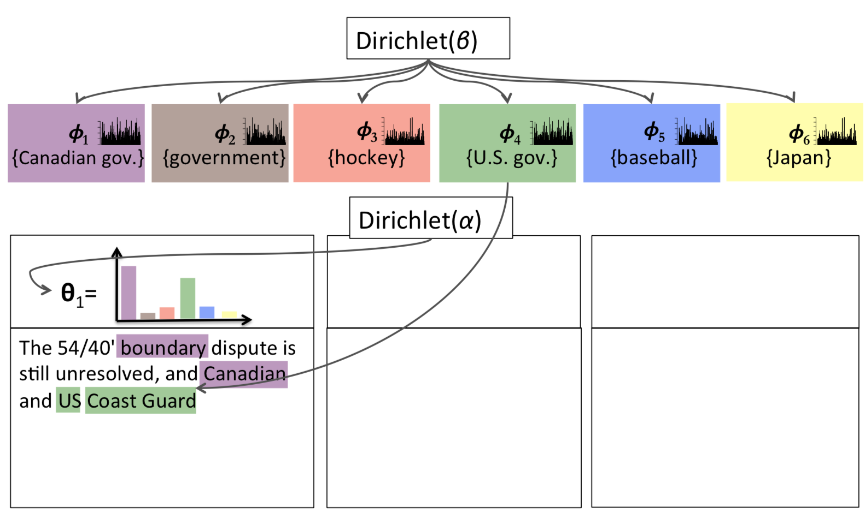
LDA Generative Process

Slide 23
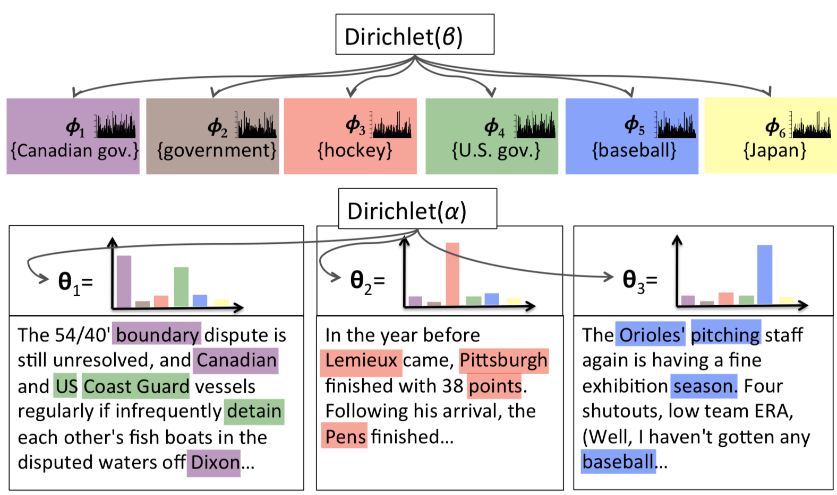
LDA Generative Process

Slide 24
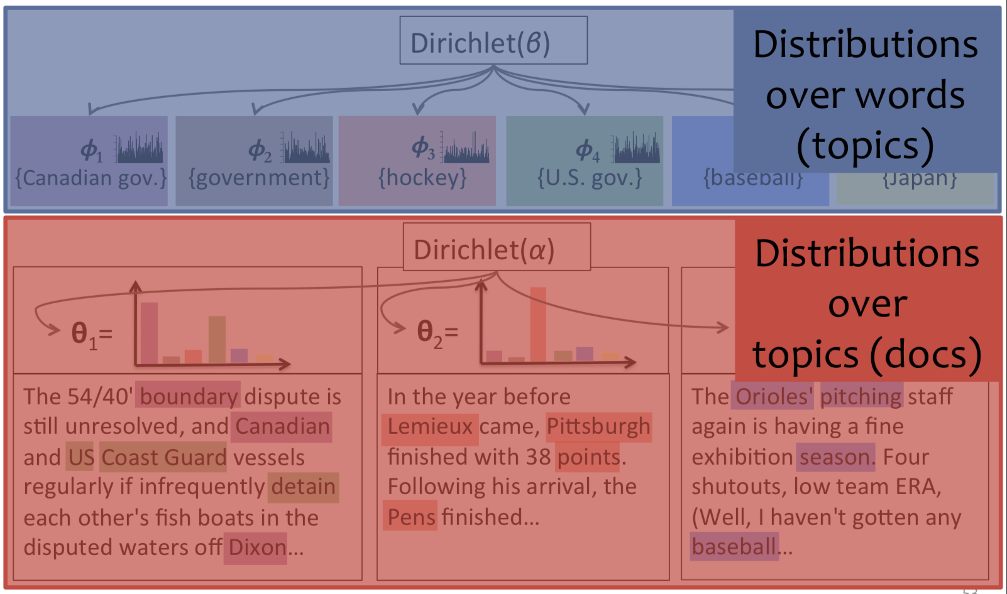
LDA Generative Process

Slide 25
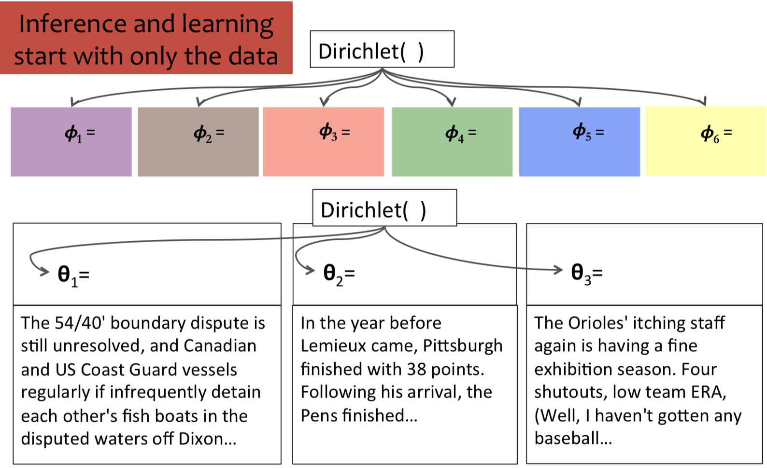
LDA Problem of Inference

Slide 26
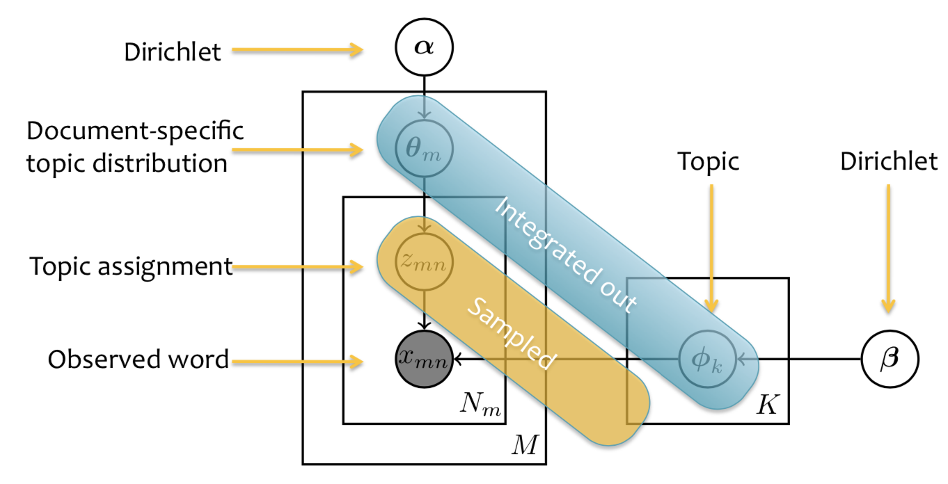
Collapsed Gibbs Sampling

Slide 27
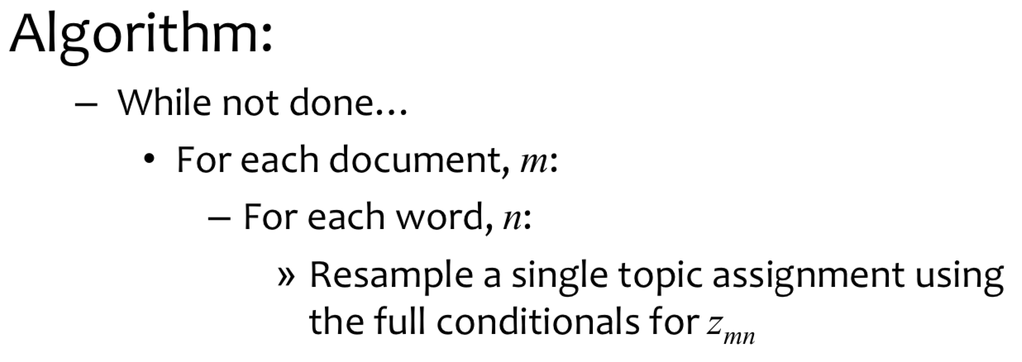
Collapsed Gibbs Sampling Algorithm
Collapsed: because we integrate out document-topic and topic-word distributions, for inference all we have to do is resample individual word-topic assignments.
Gibbs Sampling: initialize to random token-topic assignments and keep resampling token-topic assignments until empirical distribution over topic assignments in documents converges.

Slide 28
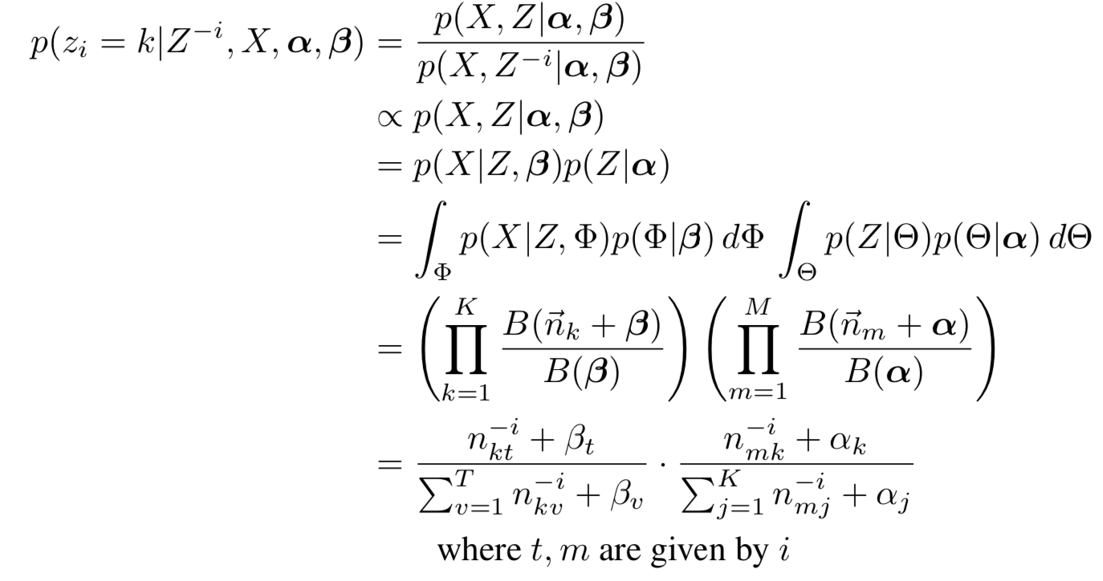
The Math to Determine Conditionals

Slide 29
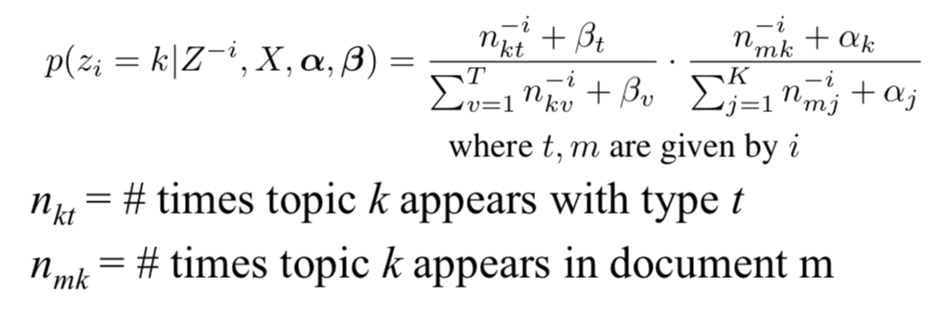
Resampling Token Topic Assignments
Below we have the probability of the i’th token in document m belonging in topic k, conditional on the current topic assignments of all of the other token-topic assignments in the document/corpus excluding the assignments of the current token.
Use this to build a probability vector to sample new token topic assignment out of.

Slide 30
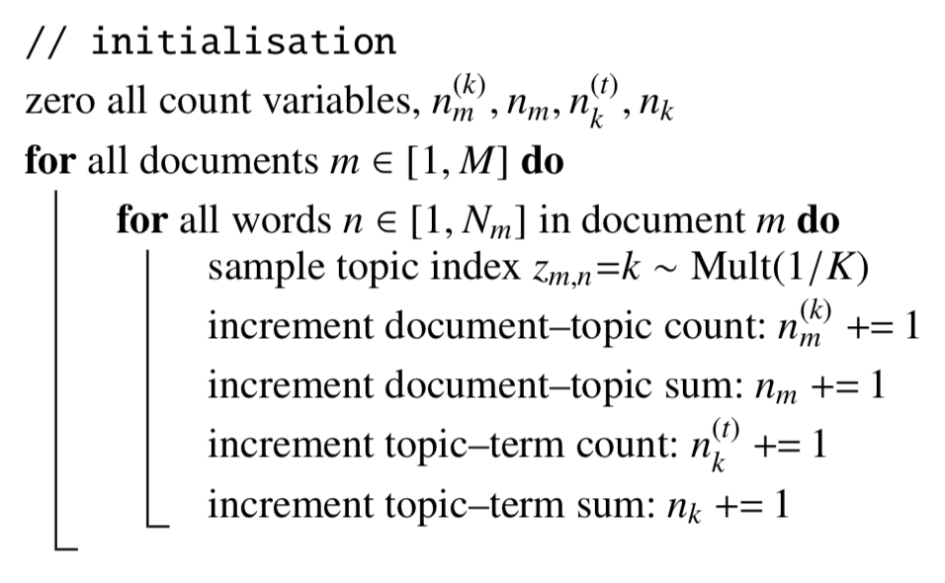
LDA (collapsed Gibbs Sampling)– Initialization

Slide 31
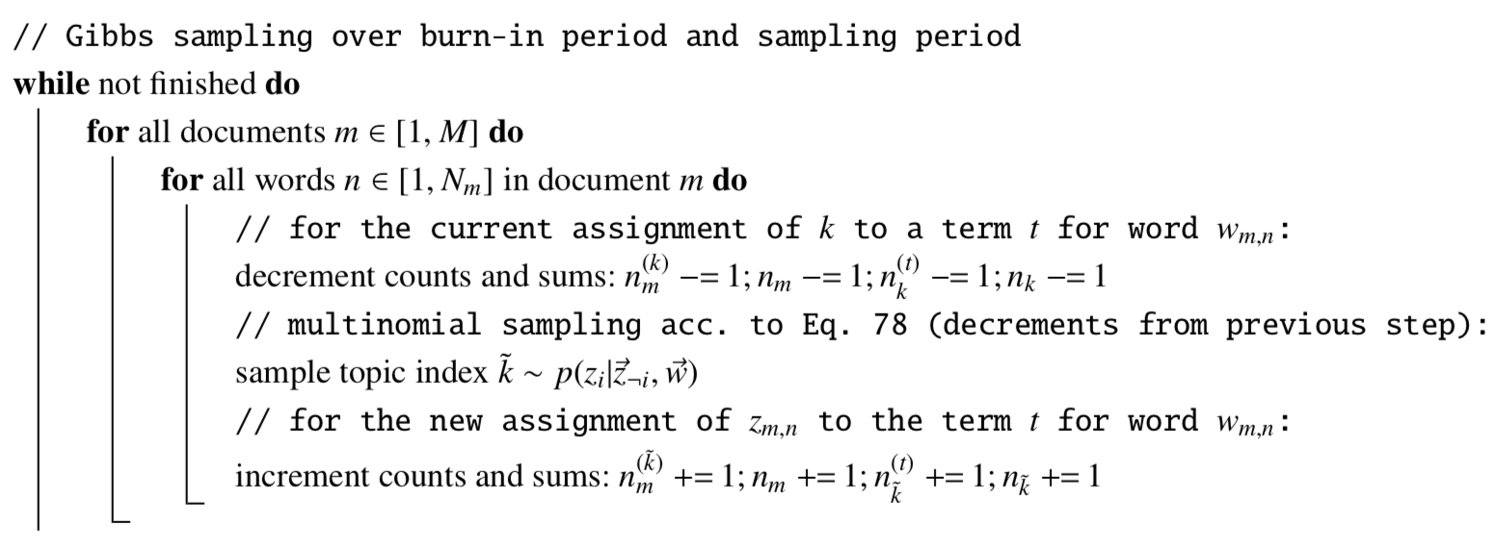
LDA (collapsed Gibbs Sampling)– Inference

Slide 32
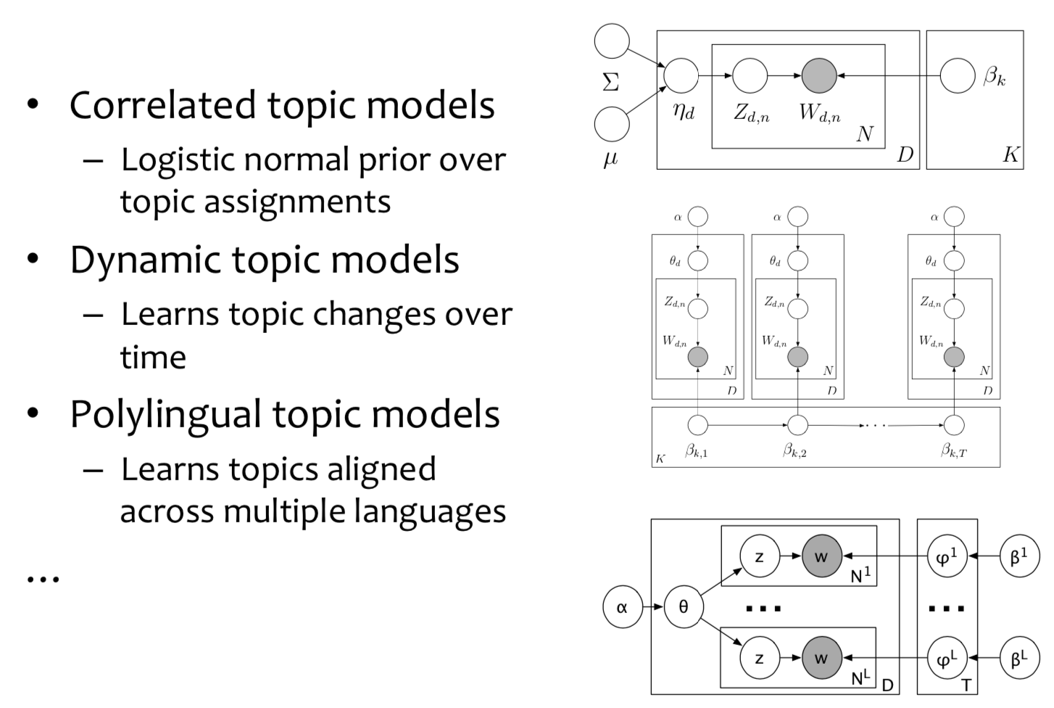
LDA Extensions

Slide 33
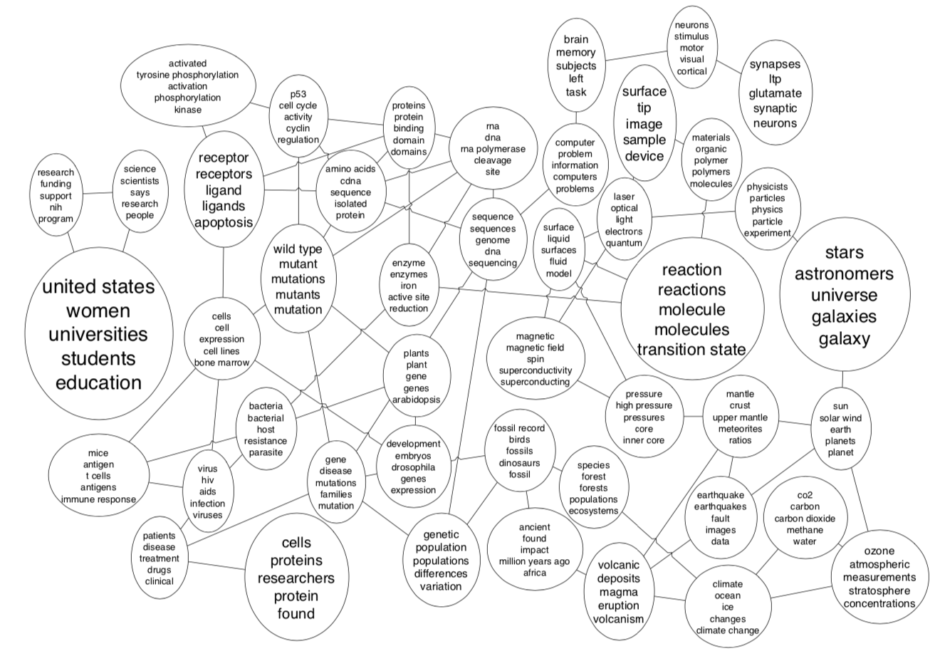
Correlated Topic Model

Slide 34
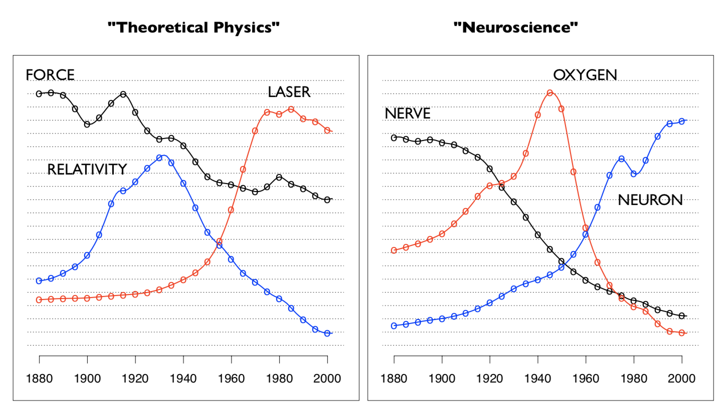
Dynamic Topic Model

Slide 35
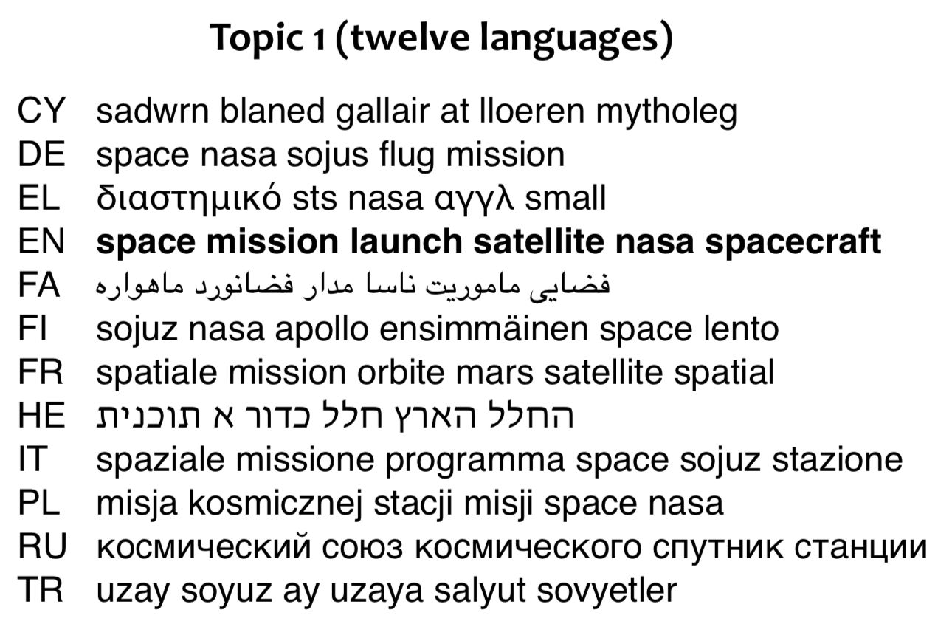
Polylingual Topic Models

Slide 36
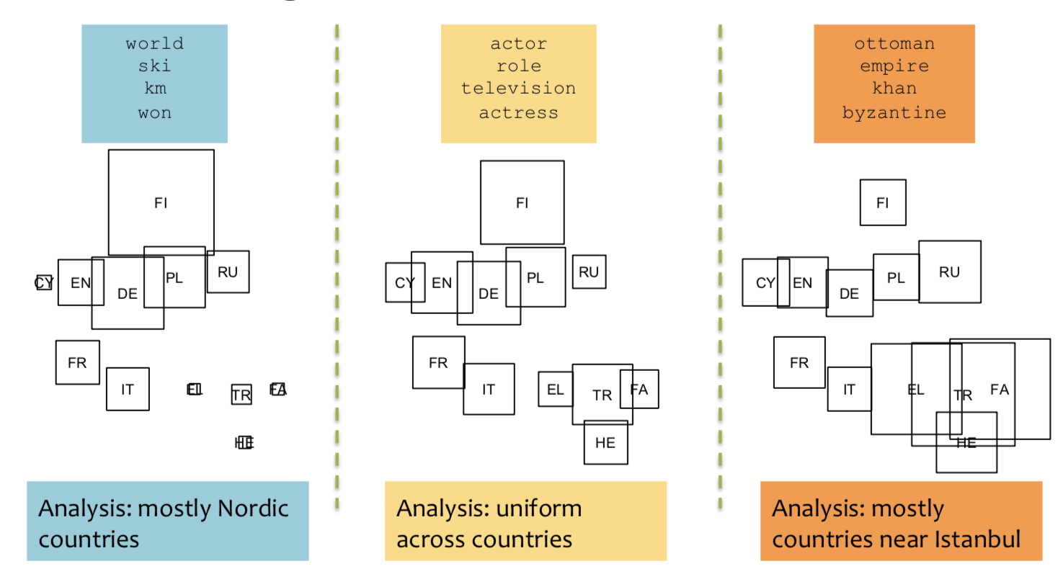
Polylingual Topic Models

Slide 37
Topic Models – My Take
Topic models can be a valuable tool for discovering themes/topics in a corpus.
There are lots of different extensions (which have varying usefulness, some of which have questionable properties).
As much as topic models are unsupervised, and thus (theoretically free from human bias), researcher decisions have a huge impact on results.
PreText (Denny and Spirling, 2018)
Choice of hyper-parameters (number of topics, concentration parameters, iterations, etc.).
Rerunning model with a different seed will change results.

Slide 38
Topic Models – My Take
To serve as a valid basis for measurement, need to run your topic model only once.
Validation (quantitative and qualitative is key).
Experience (understanding how to preprocess data generally for interpretable results, how to select model hyper parameters, etc.) is key to not cherry-picking results from multiple model runs.
Accessing many of these models will require you to step outside of R/python.
Implementing collapsed Gibbs sampling for LDA from scratch is a good exercise if you are interested in programming.

